Slide 1
Images of Rothley Court
compiled by Terry Sheppard

Slide 2
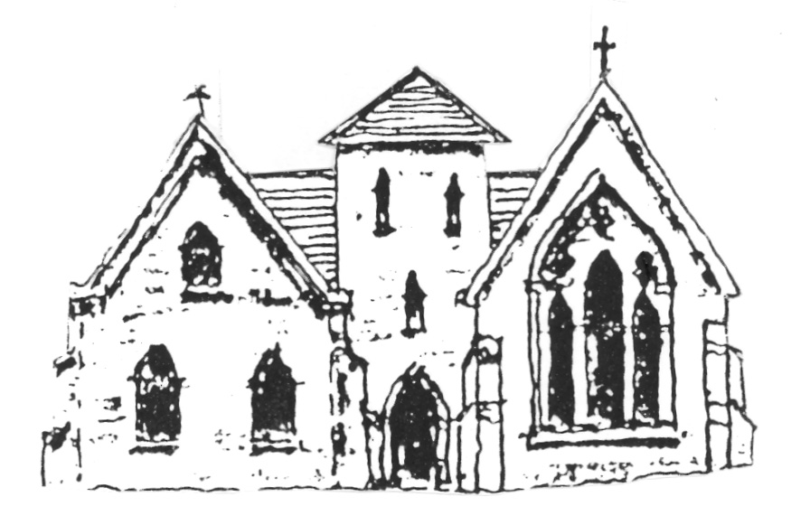
1250 temple Artists’ impression of the likely combination of structures erected by the Templars after 1231, featuring a tower between hall and chapel.

Slide 3
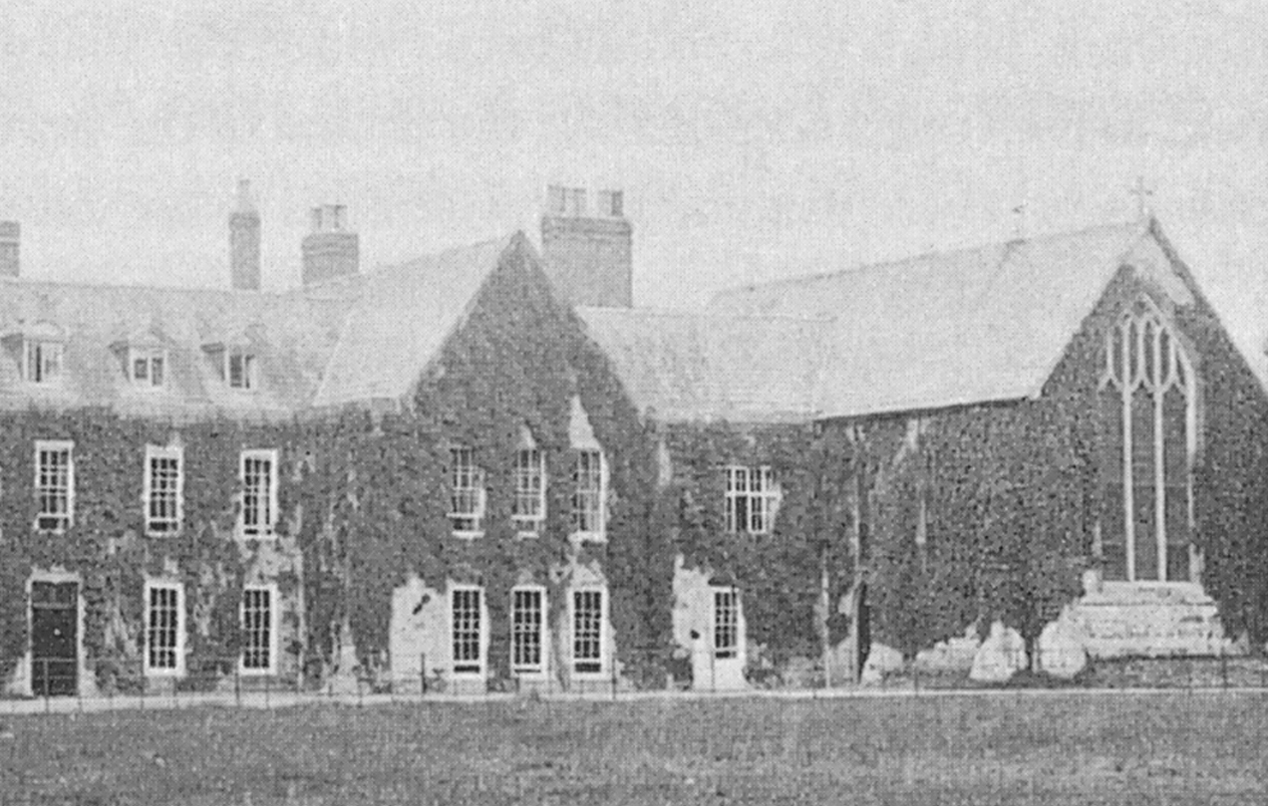
Pre 1894 Macaulay Study The chapel end of the mansion as it was before the re-ordering by Frederick Merttens in 1894. Macaulay used the room at the base of what would have been the tower. From there he could see who was coming to visit the Temple and easily escape through the window if he did not want to part of the household for a while.

Slide 4
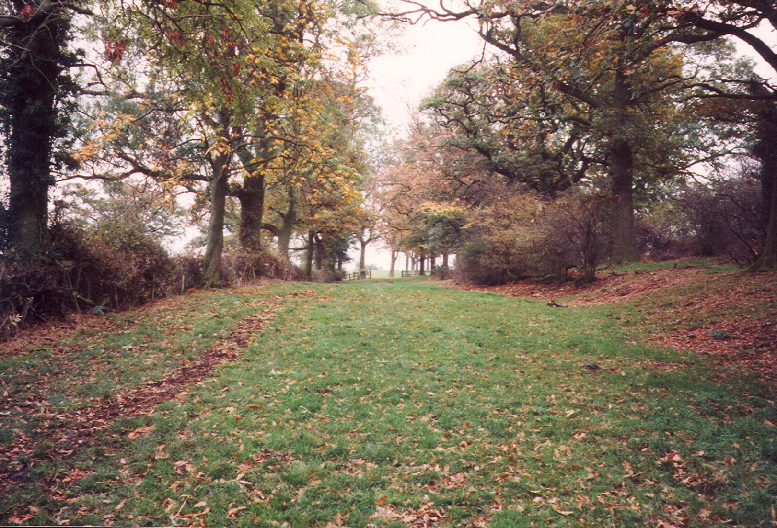
Acclivity A modern photograph along the line of the old carriage route through the banked section… the acclivity of Trevelyan’s account. Looking east.

Slide 5
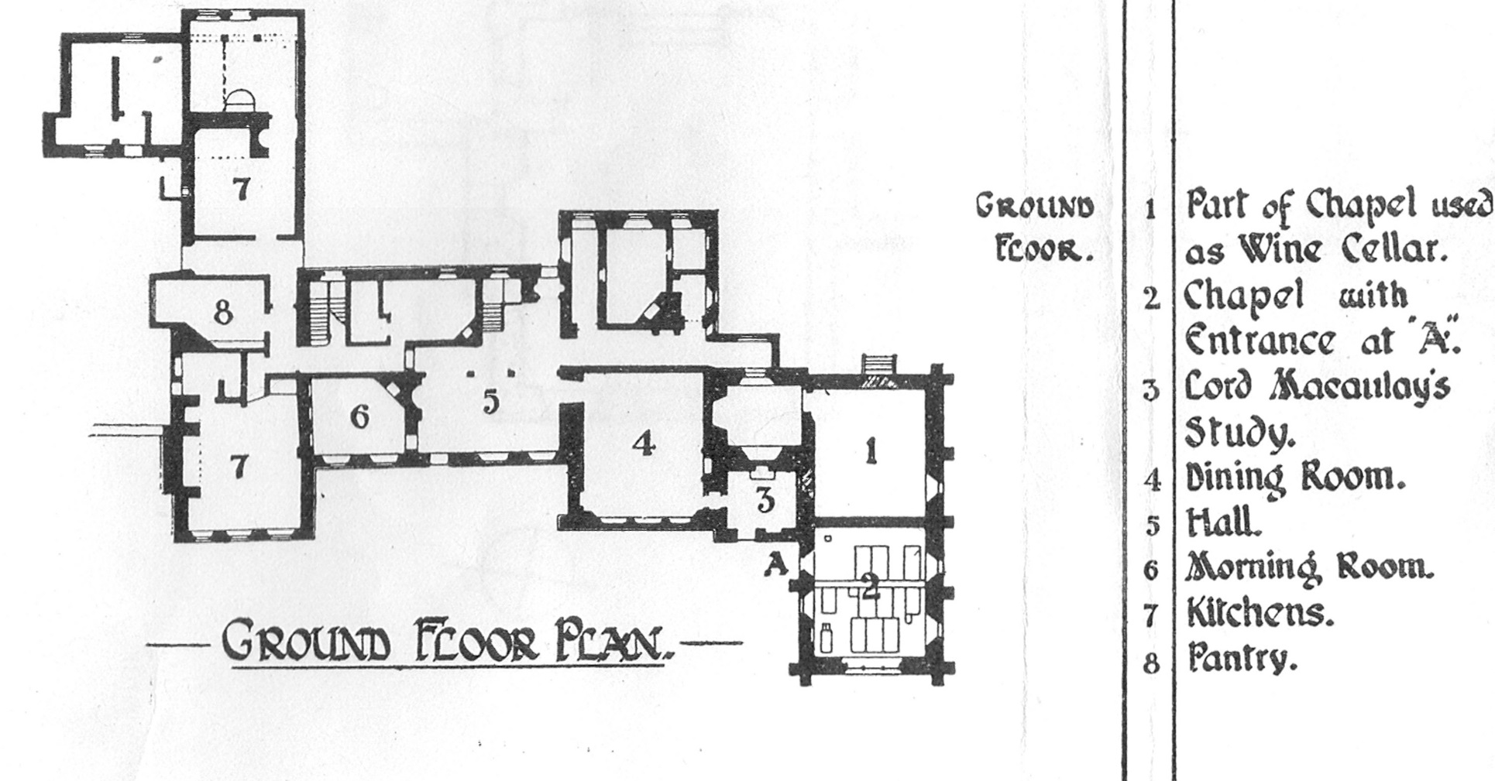
Plate 1 ground floor A rendering of the layout of the Babington-era Temple as recorded in the 1921 Study by the Leicester Archaeological & Historical Society.

Slide 6
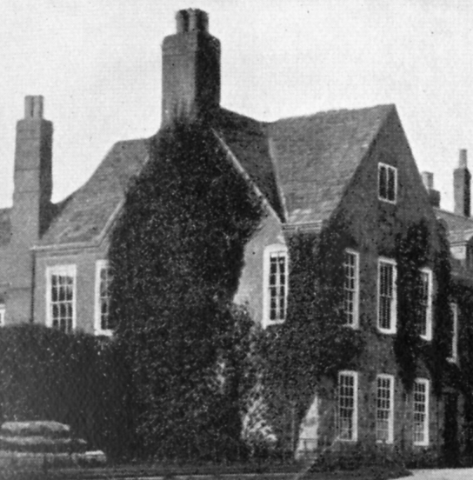
Pre-1895 Macaulay Birthroom A pre 1895 image of the upstairs corner room where TBM was born.

Slide 7
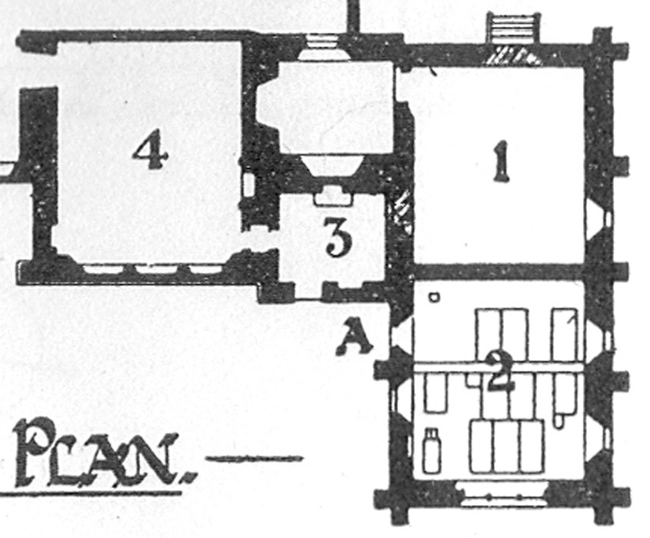
TBM’s study A cropped image from the 1921 study’s Plate 1 showing the room used by TBM as a study. He would never of course have used it at the stage when he was a Baron.

